Slide 1
Leading with Identity: Azure Active Directory
Joe Losinski
Partner Technology Strategist

Slide 2


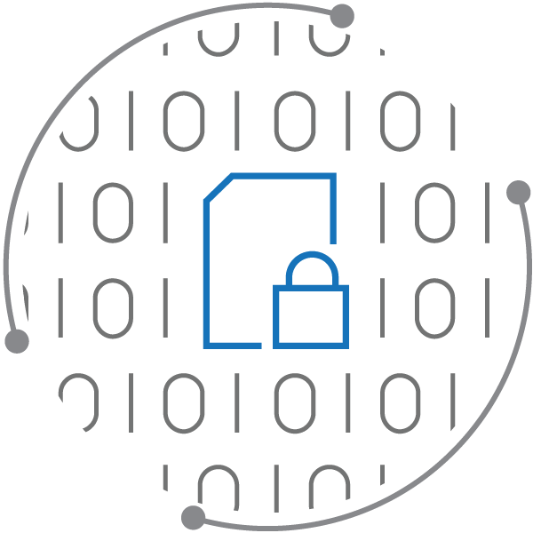
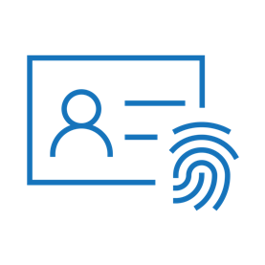

Microsoft 365 Security
Threat
protection
Identity & access management
Security management
Information protection
Data is your most important company asset
Security starts with great
user authentication
Correlate threat information and automatically respond
Optimize with security insights and configuration tools
Notes:
Reference slide from the M365 Security presentation (L100) to provide context of where Identity fits in our security portfolio.
An organization's data is their most valuable asset, yet most enterprises aren’t doing enough to control access to that data.
Security requires a layered approach. That starts with a great user authentication experience with automatic, policy-based rules for access to sensitive information regardless of location or device type.
Once that’s in place you can apply threat protection and security management tools to keep users, data, devices, and applications safe and optimize your security posture.
Today, we’re going to talk about Identity & Access Management

Slide 3
User credentials are constantly at risk of a breach
81%
73%
80%
of breaches are caused by credential theft
of passwords are duplicates
of employees use non-approved apps for work
Notes:
User credentials are constantly at risk. 81% of breaches are caused by compromised credentials (Verizon Data Breach Investigations 2018 report)
73% of passwords are duplicates (Telesign 2016 consumer account security report)
80% of employee use non-approved apps for work
86% of cases where personally identifiable information (PII) was compromised started with a phishing attack (use phishing as the initial attack vector)
This is why user identity is the most important thing to protect. Once a malicious actor has compromised a user identity they can log into the device as you and they have the device. Then they can log into your apps as you and then they get your data. P0wning a user is easy. Compromising a physical device is harder.
Good News: 99% of attacks thwarted by multi-factor authentication (Microsoft 2018 reported figure based on the billions of authentications we see each day

Slide 4
Identity challenges for today’s organizations
Explosion of apps, devices, and users outside of the corporate network
Increase in identity attacks and lack of visibility and control
Evolving data privacy and security regulations to comply with
Demands for increased productivity and IT modernization
Notes:
Here are some of the challenges customers are facing related to identity and access in their organization.
Identity attacks continue to increase. There was a 300% increase in identity-related attacks last year.

Slide 5

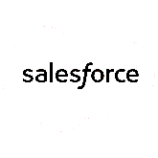


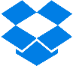

Identity is the new control plane
Cloud apps
Partners & customers
Employees
Identity
On-premises apps
Devices
Notes:
An organization’s data can be spread across multiple applications, on-premises and in the cloud, and accessed by multiple devices and users, internal and external.
Identity can be the central point of control that connects it all. You need a comprehensive identity and access management solution that protects your internal and external users, but also helps your business to grow and thrive by improving the user experience and productivity.

Slide 6
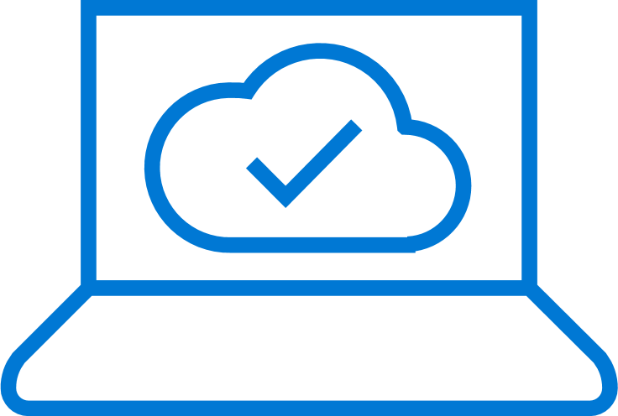
Microsoft Azure Active Directory
Your universal platform for managing and securing identities
MODERNIZE ACCESS
SECURE & GOVERN
CONNECT & COLLABORATE
DEVELOP & INTEGRATE
Connect your users to any app
Safeguard user credentials
Interact with customers and partners
Accelerate adoption of your apps
Single Sign-On
Azure AD Connect
Automated User Lifecycle
Self-Service for End Users
Access from Anywhere
Strong Authentication
Conditional Access
Identity Protection
Privileged Identity Mgmt
Identity Governance
Customer & Partner Identity and Access Management
Cross-Tenant Collaboration
Personalized Customer Journeys
Connect with Any User
Open standards-based
Identity platform
App Integration
Microsoft Graph
Identity for IaaS
Notes:
Provide an overview of the 4 product areas of our solution. Highlight key differentiators or areas that are relevant for your customer, e.g. Connect AD to AAD with Azure AD Connect (hybrid scenarios), Self-service password reset, Strong Auth with passwordless options (Windows Hello, free Authenticator app), Conditional Access (key part of our Zero Trust solution), managing partner or customer identities, developing apps for internal or external users that uses Azure AD. Can go deeper on any of these areas using slides from the Appendix, depending on customer interest.
- Connect to the challenges that resonate with the customer from slide 4.
Microsoft Azure Active Directory provides a full-featured platform with capabilities for you to manage and secure identities for your organizations.
With identity as the control plane and Azure AD, you unlock world-class security.
Azure AD can help you:
Modernize Access: Connect your users to any app with seamless single sign-on and secure access from any location. Increase productivity and reduce costs with automated identity processes, such as the user lifecycle, by adding new access rights when an employee joins or moves teams, and revoking them when the person leaves. The self-service portal will save you time & money in resetting passwords and setting up multi-factor authentication for your users.
Secure & Govern: Safeguard user credentials using a Zero Trust approach. Zero Trust is a security model where the organization always verifies first before they trust a user or device. It requires visibility into the users and devices, a policy engine, and access management. Strong authentication (MFA) and intelligent conditional access policies in Azure AD, combined with endpoint management and security in M365 E3/E5, can give you everything you need to implement a Zero Trust approach. (more on Zero Trust here: https://cloudblogs.microsoft.com/microsoftsecure/2018/06/14/building-zero-trust-networks-with-microsoft-365/). Start with a baseline of strong two-factor auth and adaptive, risk-based conditional access.
Connect & Collaborate: Interact with customers and partners and grow your business using user-centric tools and modern collaboration. Move your customer and partner identities to the cloud to provide better experiences and greater security. Easily invite partners to collaborate and manage their access. Personalize the user journeys for registration and sign-in to your apps and services from a web or a mobile device with our B2C solution.
Develop & Integrate: Accelerate adoption of your apps. As organizations move their identity systems to the cloud, you need applications that you use and develop to integrate with your enterprise identity system. With Azure AD as your platform, it provides a tremendous opportunity for developers to integrate into this ecosystem. We use open standards (non-proprietary) so it can be interoperable with other apps and services.

Slide 7
Why Microsoft

Slide 8
The world’s #1 enterprise identity service
19.3 M
1.2B
810 K
organizations
identities
Third-party apps
in Azure AD
100M
8 B
90 %
paid Azure AD/EMS seats
daily Azure AD authentications
of Fortune 500 companies
Jan 2019
Notes:
Why Azure AD?
19.3M and 1.2B: Azure Active Directory manages more identities for more organizations than any other identity provider on the market.
810K: More than 810k non-Microsoft apps are connected to Azure AD. We can support on-prem, cloud, and virtually any app you have.
104M: This is the number we are most proud of. There are now over 100M paid Azure AD seats. For comparison, Okta has about 5% of this total.
8B: Billions of Azure AD authentications EVERY DAY, far more than any other competitors. For comparison, Okta has about 8B authentications PER YEAR.
90% of Fortune 500 companies use Azure AD. Companies of every size and every industry use Azure AD! (see customer reference slide at the end)
See Compete resources for Okta and recorded Ready session.

Slide 9
The most trusted platform
Over 100 datacenters across the planet
Each physical datacenter protected with world-class, multi-layered protection
Secured with cutting-edge operational security
Restricted access
24x7 monitoring
3500+ global security experts
Global cloud infrastructure with secure hardware and data segregation
Notes:
It starts with operational excellence in the cloud (clock-wise on the globe)
Physical security
Operational security
Global cloud fabric that runs our clouds (Office365, Azure) and our security services
The first side is the secure foundation of our cloud services. This is about how we operate our own cloud services, Azure, Office 365 and so forth. We have some of the world's best physical security, with fences and barbed wire and so on to provide secured building environments and within those buildings, secure server environments.
To enter a server environment, for example, a person would have to pass through multiple physical layers and provide multiple forms of identification. They would also be scanned for metal in their pockets to make sure that they are not bringing devices in to steal information. So, there's a great deal of physical security in place that we do on behalf of all of our customers in our cloud services and that make it possible for our customers to really leverage the investment that we've made in that respect.
Operational security I touched on a minute ago when we talked about the human piece of the Intelligent Security Graph. One of the ways this comes to life is in our continual testing of our services, making sure that that we're finding vulnerabilities faster than the bad guys can. We have a big focus on red team, blue team exercises. If you're not familiar with those, the idea is that we have dedicated professionals whose job it is to be on the good side but act like the bad guys—they’re constantly trying to find ways to penetrate the services, find ways that hackers might attack us so that we can shore up our defenses.
Another example of our operational excellence is around restricted access. When Microsoft employees need elevated access so that they can do maintenance on a service, or so they can investigate a customer support issue, they only have access to exactly the resources they need to access and for only exactly the amount of time that they need it. So, they have just in time and just enough access to do their work, and then they get out. They don't have any standing elevated access that allows them to view customer data.
And this is something, again, where we can make an investment at Microsoft that gets heavily leveraged because all of our customers benefit.
Lastly, customer controls are a huge important part of this. This is something that we get asked about a lot when we talk to customers about our cloud services. What are the things that I have at my control so that I can decide how I want to manage my data and access to it? Access controls, of course, are the very foundation of it. Multi-factor authentication for admins at customer sites who are in charge of operating Azure for that customer or operating Office 365. Having multi-factor authentication of course is a basic that we think is fundamental.
And lastly, network and distributed denial of service protection is in place for all of these services. We do basic protection to ensure our services work reliably, and Azure customers can take advantage of additional protection at the network layer to suit their needs.

Slide 10

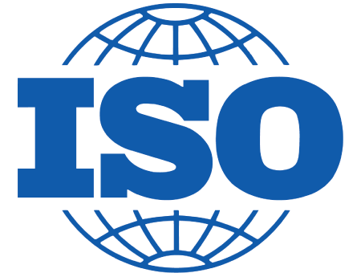











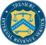










The most compliant platform
6
More certifications than any other cloud provider
Industry leader for customer advocacy and privacy protection
Unique data residency guarantees
Microsoft is committed to GDPR compliance
Notes:
Microsoft is committed to meeting industry and government regulatory requirements for our customers. We have more certifications than any other cloud provider.
For more info: https://azure.microsoft.com/en-us/overview/trusted-cloud/

Slide 11

6.5 trillion correlated signals per day
Shared threat data from partners, researchers, and law enforcement worldwide
Microsoft Intelligent Security Graph
OneDrive
930M threats detected on devices every month
Outlook
400B emails analyzed
1.2B devices scanned each month
200+ global cloud consumer and commercial services
Botnet data from Microsoft Digital Crimes Unit
Windows
Enterprise security for 90% of Fortune 500
Azure
Microsoft accounts
18B+ Bing web pages scanned
Bing
450B monthly authentications
1.1B+ Azure user accounts
Xbox Live
Notes:
The center piece of our investment in intelligence is the Microsoft Intelligent Security Graph. This is how we describe the way that we synthesize a vast amount of data from a huge variety of sources. 400 billion emails get analyzed by our Outlook.com and Office 365 email services every month.
1.2 billion devices get scanned every month by Windows Defender. That gives us a great deal of signal into what's happening on endpoints, and where are the attacks, and what do they look like these days?
We operate 200-plus global cloud, consumer, and commercial services. Everything from outlook.com to Xbox Live to Office 365 to Azure, and so on. And with all of those services, we have a tremendous amount of surface area that we defend. Enterprise Security from Microsoft is employed by 90% of the Fortune 500.
And so, we see more attacks than most other companies on any given day. We get a lot of information from defending against those attacks.
750 million plus Azure user accounts give us tremendous insight into how people authenticate to Azure. And that, combined with the 450 billion monthly authentications that we do with Azure Active Directory and Microsoft Account, really give us some tremendous insight into what is normal behavior when it comes to sign-ins and authentications, and what is abnormal behavior, and how often is it that someone has the right password, but they're not the person they say they are. We learn a lot about defending that really important control point, the identity, by looking across that set of data.
Bing scans about 18 billion web pages every month, giving us really great insight into what people are doing with web scripting technologies when it comes to attacks and phishing campaigns. And we have a great way to look at that and understand how we should help customers defend based on that information.
On top of all of that we layer shared threat data that we get from our partners, from the researchers here at Microsoft who are part of our 3,500-plus people that are full time on security, and law enforcement agencies that we partner with worldwide through our digital crimes unit, as well as botnet data that we collect through the digital crimes unit. All of that intelligence makes up the Intelligent Security Graph.
And why is it a graph? It's a graph because what's really important is connecting these pieces of intelligence, so that these signals are not just individual points of information. The graph brings them together as something that we can draw patterns across. We can learn from one point of data to influence how we interpret another point of data.
So, the Intelligent Security Graph is something that we are very, very heavily invested in at Microsoft. It's something that we feel is unique to us in this industry.

Slide 12

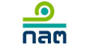





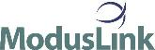



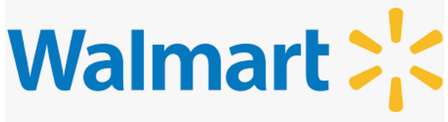

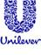






















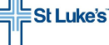
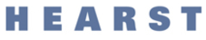
Customer stories
Transportation, logistics, and oil-gas
Retail, hospitality, and travel
Government, banking, and insurance
Construction and professional services
Education and nonprofit
Health
Notes:
Just a sample of our customers in various industries.
Wholefoods: https://customers.microsoft.com/en-US/story/whole-foods-takes-natural-next-step-to-protect-applications-in-the-cloud
Hermes: https://customers.microsoft.com/en-US/story/hermes-expedites-mobile-data-access-and-security-with-the-microsoft-enterprise-mobility-suite
Pepsi: https://customers.microsoft.com/en-US/story/gj-pepsi-bubbles-up-good-ideas-by-equipping-field-workers-with-secure-managed-mobile-devices
Bristow Group: https://customers.microsoft.com/Pages/CustomerStory.aspx?recid=28655
Real Madrid C.F.: https://customers.microsoft.com/Pages/CustomerStory.aspx?recid=20522
Royal Dutch Shell: https://customers.microsoft.com/Pages/CustomerStory.aspx?recid=28376
QANTAS: https://customers.microsoft.com/en-US/story/qantas-airways-limited-australia
Türkiye Finans Bank: https://customers.microsoft.com/Pages/CustomerStory.aspx?recid=27754
Vereniging Natuurmonumenten: https://customers.microsoft.com/Pages/CustomerStory.aspx?recid=28253
Japan Advanced Institute of Science and Technology (JAIST) https://customers.microsoft.com/Pages/CustomerStory.aspx?recid=28348
Soap Japan https://customers.microsoft.com/Pages/CustomerStory.aspx?recid=28159
Click View: https://customers.microsoft.com/Pages/CustomerStory.aspx?recid=28976
Presence Health https://customers.microsoft.com/Pages/CustomerStory.aspx?recid=2979
Innofactor https://customers.microsoft.com/Pages/CustomerStory.aspx?recid=28453
Somerset College: https://customers.microsoft.com/Pages/CustomerStory.aspx?recid=27625
GeoSafe: https://customers.microsoft.com/Pages/CustomerStory.aspx?recid=26955
Containerships: https://customers.microsoft.com/Pages/CustomerStory.aspx?recid=27715
Wijkracht: https://customers.microsoft.com/Pages/CustomerStory.aspx?recid=25866
Jet.com: https://customers.microsoft.com/Pages/CustomerStory.aspx?recid=23392
ModusLink: https://customers.microsoft.com/Pages/CustomerStory.aspx?recid=23164
NAV CANADA: https://customers.microsoft.com/Pages/CustomerStory.aspx?recid=18699
Morisawa Corporation: https://customers.microsoft.com/Pages/CustomerStory.aspx?recid=24880
Walsh Group - Construction Firm Moves Workloads to Public Cloud to Gain Greater Agility, Scalability
SoftBank Technology: https://customers.microsoft.com/Pages/CustomerStory.aspx?recid=21978
AccelRelation: https://customers.microsoft.com/Pages/CustomerStory.aspx?recid=23318
St. Luke's Health System: https://customers.microsoft.com/Pages/CustomerStory.aspx?recid=21651
Village Vanguard: https://customers.microsoft.com/Pages/CustomerStory.aspx?recid=23285
FHI 360 - Nonprofit Uses Cloud to Cut Infrastructure Costs by 90 Percent, Saving $415,000 Annually
Canadian Cancer Society: https://customers.microsoft.com/Pages/CustomerStory.aspx?recid=20345
Mattamy Homes - Homebuilder enables enterprise mobility with cloud-based tools to help achieve revenue growth
ABM - Facility services firm uses cloud tools to build productive mobile work environment
Mitchell Shire Council :https://customers.microsoft.com/Pages/CustomerStory.aspx?recid=21688
Jönköping County Council - Swedish County Council Improves Community Care Delivery Using Cloud-Based Mobility Tools
Willemen Groep - Construction firm reduces costs, boosts productivity with cloud-based mobility tools
INAIL - Nonprofit Uses Cloud-Based Mobility Tools to Help Staff to Improve Worker Health and Safety
Shropshire Council - County Council Boosts Service, Reduces Costs by Using Cloud-Based Mobility Tools
Lotus F1 Team: https://customers.microsoft.com/Pages/CustomerStory.aspx?recid=22458
Universidad Anáhuac Mayab: https://customers.microsoft.com/Pages/CustomerStory.aspx?recid=9252
The MANN+HUMMEL Group: https://customers.microsoft.com/Pages/CustomerStory.aspx?recid=19008
DOMCURA AG: https://customers.microsoft.com/Pages/CustomerStory.aspx?recid=28342
Sigorta Cini: https://customers.microsoft.com/Pages/CustomerStory.aspx?recid=28629
SATS ELIXIA: https://customers.microsoft.com/Pages/CustomerStory.aspx?recid=19519
Securities and Exchange Commission: https://customers.microsoft.com/Pages/CustomerStory.aspx?recid=25230
SPAR: https://customers.microsoft.com/Pages/CustomerStory.aspx?recid=26768

Slide 13
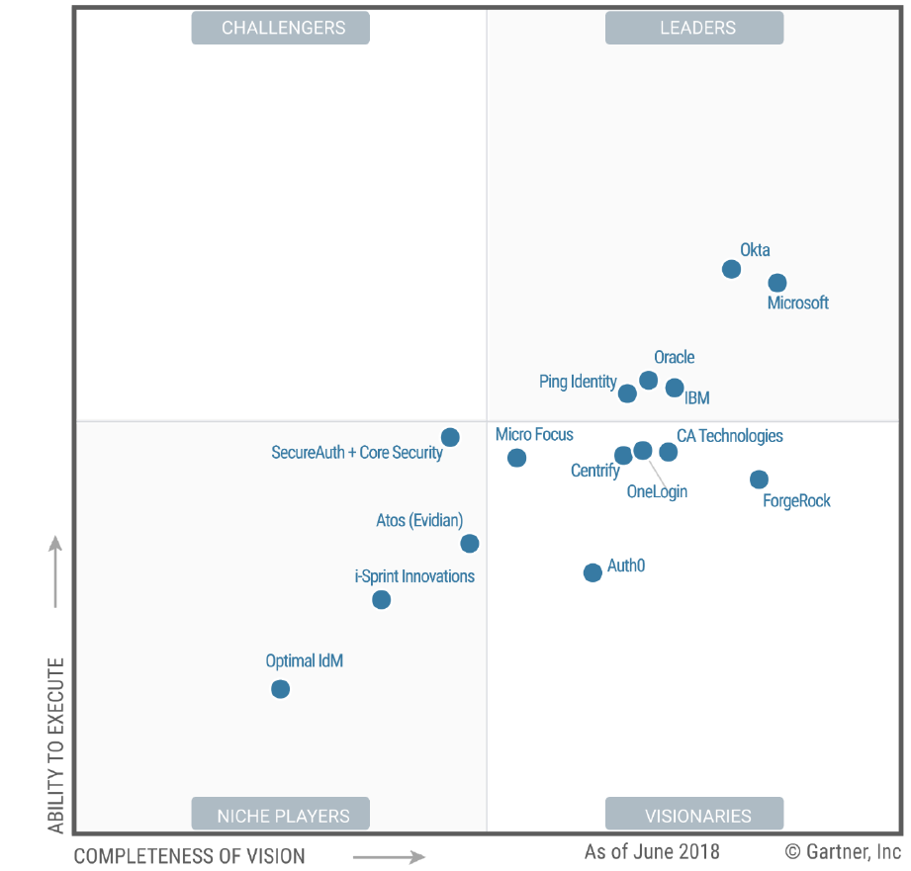
Microsoft is a leader in Access Management for Vision & Execution
At Microsoft, we focus on both vision and execution of our strategy to help you where you are at today and for the identity needs of tomorrow.
Source: Gartner, Inc., Magic Quadrant for Access Management
This graphic was published by Gartner, Inc. as part of a larger research document and should be evaluated in the context of the entire document. The Gartner document is available upon request from Microsoft. Gartner does not endorse any vendor, product or service depicted in its research publications, and does not advise technology users to select only those vendors with the highest ratings or other designation. Gartner research publications consist of the opinions of Gartner’s research organization and should not be construed as statements of fact. Gartner disclaims all warranties, expressed or implied, with respect to this research, including any warranties of merchantability or fitness for a particular purpose.
Notes:
Get the report: https://www.microsoft.com/en-us/microsoft-365/blog/2018/06/25/vision-execution-microsoft-named-a-leader-again-in-gartner-mq-for-access-management/
The Gartner MQ is an important decision making guide for corporate IT departments. For example, some organizations have “best of breed” policies that dictate they may only purchase products in the Leader quadrant.
The Magic Quadrant report highlighted our Strengths as the compelling bundle of EMS and M365, our improved admin experiences, identity protection and conditional access (include cross-EMS controls). Cautions are additional components/licensing required for header-based auth (we partner with Ping Access for this), B2C immaturity and unpredictable pricing (April 2019 – lower cost and GA of custom policies using our differentiated IEF technology), and support for third-party identity providers for B2B (Ignite 2018 we added Gmail and Feb 2018 we added sign-in by one-time-code from any email).
Comparatively, Okta’s Strengths are growth and investment (significantly less than ours), positive feedback from customers, LDAP interface, and improved developer experience due to Stormpath acquisition. Their Cautions were a lack of reverse proxy and header-based auth support (contrasting with ours just being complex), and their pattern of dropping or electing not to build functionality like MDM, data protection and CASB in favour of partnerships. This suggests the EMS strategy is setting industry expectation for our segment. Okta’s lack of profitability is also a Caution.
Notable Vision competitor ForgeRock is on-prem only.

Slide 14
Azure Active Directory Modernize Access

Slide 15
Start with an identity foundation from the cloud
MODERNIZE ACCESS
Seamless access to apps
Automated provisioning
Empower self-service
Right for the modern workplace, right for the hybrid world.
Notes:
Can your users seamlessly access all of their apps and resources?
Are you automating the provisioning of user data across your identity infrastructure?
Are you efficiently scaling IT management through user self-service, reporting, and monitoring?
As part our your journey through hybrid identity, there are a few key items to consider:
To unlock security and management features of the cloud, how do you most efficiently drive a common identity between Azure AD and your on-premises directory?
How can users be granted access to any resource, regardless of on-premises or cloud app, from anywhere in the world in a secure manner?
How can all of this be driven without making major deployment efforts beyond investments already made for on-premises?

Slide 16






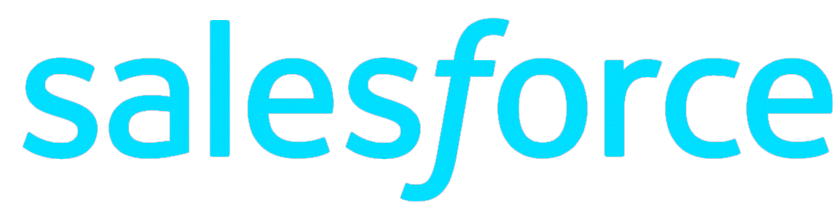
Seamless access to apps
MODERNIZE ACCESS
One common identity for single sign-on
Connect users to ALL the apps they need
Microsoft Azure
Active Directory
Access on-premises apps without using a VPN
Azure AD Connect
On-premises /
Private cloud
Notes:
The first thing you need to do is to connect your on-premises Active Directory to the cloud with Azure AD Connect. Azure AD Connect is the Microsoft tool designed to meet and accomplish your hybrid identity goals. This allows you to provide a common identity for your users for Office 365, Azure, and SaaS applications integrated with Azure AD. At its core, it enables synchronization between on-premises and cloud identity infrastructures. Specifically, it creates users, groups, and other objects and ensures data is consistent between directories. Once user data is extended with the sync engine, the next consideration is a secure method to authenticate users.
App Proxy lets you use Azure AD as your authentication and authorization service for your on-premises apps as well as your cloud apps. This lets users who are remote from your business to get back to on-premises apps that are claims aware. We’ll use lightweight connectors in your firewall to do this, which lets you expose just the apps you want a user to get into out wherever they are out in the world while applying all of your common policies and security posture to them, without having to open up a VPN.
And let’s be real, VPNs are scary. Most corporate hacks start by compromising a user account, and then immediately heading to a VPN. And once I’m on your VPN, I’m in the network and I can take over pretty much whatever I want.

Slide 17















Azure Active Directory 3rd party applications
MODERNIZE ACCESS
ServiceNow
Google Apps
Workday
SuccessFactors
Schoology
Concur
Salesforce
810,000
Workplace by Facebook
20M
Myday
Canvas
active apps integrated with Azure Active Directory
Cornerstone OnDemand
monthly active users of 3rd party apps
Blackboard Learn
Clever
Box
Firefly
# monthly active users
September 2018
Notes:
Our usage is growing by leaps and bounds! Checkout some of the biggest hitters for our customers.

Slide 18
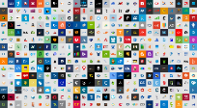
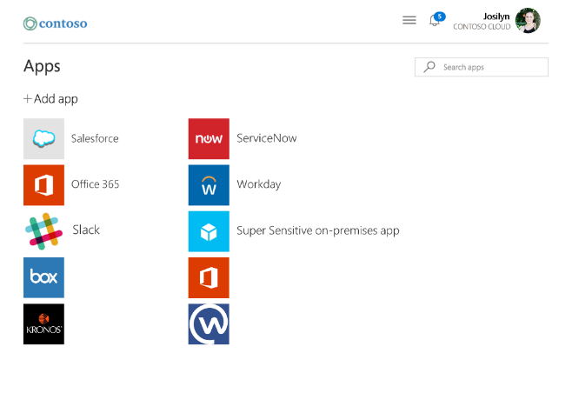
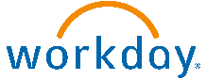
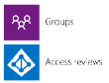
Automated user lifecycle
MODERNIZE ACCESS
Access panel
HR app
Dynamic groups
Microsoft Azure Active Directory
Box
Office 365 SharePoint Online
Kronos
Workplace by Facebook
On- premises
Notes:
This slide has animation showing the user update coming from HR and dynamically updating access permissions.
User automated user provisioning
Drive identity source-of-truth from HR tools
Automate the join/move/leave process

Slide 19
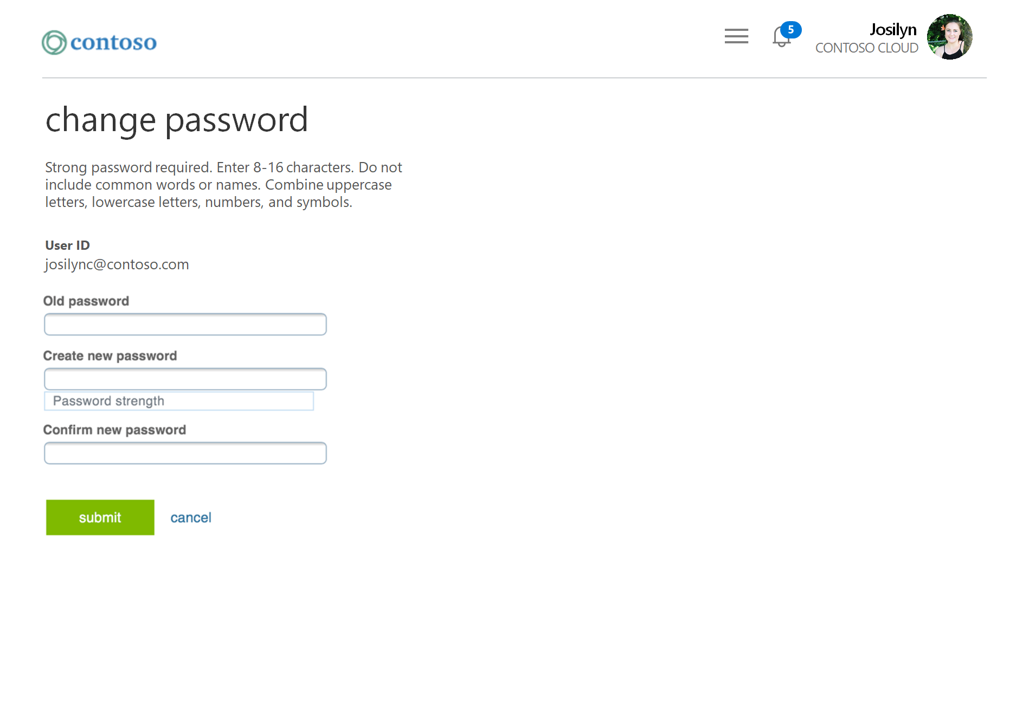
Empower user self-service to save time and money
MODERNIZE ACCESS
username
????????
Resolving password issues for users is one of the largest IT costs
Maximize user flexibility by enabling resets from an intuitive web interface or directly from the Windows login screen

Slide 20
Azure Active Directory Connect & Collaborate

Slide 21
CONNECT & COLLABORATE
Transform management of external identities
User-centric and flexible
Secure and reliable
Global and scalable
Notes:
As part our your digital transformation journey with customers and partners, there are a few key questions to consider.
Can your business partners easily collaborate with you?
Do customers have a user-friendly experience for signing up and signing in?
Are you able to ensure security and data protection for external users, while providing a reliable, 24/7 service?
How does Microsoft help?
User-centric and flexibly
Secure and reliable
Global and scalable

Slide 22


Seamless partner collaboration
CONNECT & COLLABORATE
Simplified collaboration with business partners around the world
Contoso Content
Fabrikam User
Contoso Sign In
Fabrikam Sign In
Authentication separated from authorization

Slide 23











Azure Active Directory B2C
CONNECT & COLLABORATE
Connect to any user on any platform
Analytics
Securely authenticate your customers using their preferred identity provider
Microsoft Azure
Active Directory
Capture login, preference, and conversion data for customers
Provide branded (white-label) registration and login experiences
contoso
Social, email, or local IDs
Business & Government IDs
Apps and APIs
Customers

Slide 24



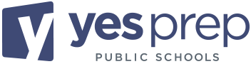


18 Schools
13,300 Students
“Azure AD B2C was our solution of choice because it not only meets FERPA regulations, but it also helps us manage identities at scale, all while being cost-effective and secure.”
Troy Neal
Managing Director of Information Services
87% Economically Disadvantaged
97% Hispanic and African American
Notes:
https://customers.microsoft.com/en-us/story/737683-YesPrep-azure-activedirectory
guardians could not easily access student records. To alleviate the issue, it decided to build a parent portal that takes advantage of Microsoft Azure Active Directory B2C (Azure AD B2C) and multi-language support to provide the 30,000–40,000 parents and guardians in the network secure access to student information in their preferred language.
As a public charter school system, YES Prep Public Schools must ensure compliance with the Family Educational Rights and Privacy Act (FERPA), a federal law that governs access to educational information and records. Guaranteeing comprehensive protection of privileged and confidential student data was an imperative solution requirement.
Prior to the implementation of a parent portal, student records were stored on several internal, disparate, and siloed systems. With over 1,500 faculty and staff operating 18 schools and supporting over 13,000 students, these internal systems could not scale to meet the functionality required for a parent portal while maintaining FERPA guidelines. It needed a comprehensive solution.
YES Prep Public Schools selected Azure AD B2C as the identity and access management solution for its parent portal due to the solution’s ability to protect user identities while performing at scale. The organization also recognized Azure AD B2C as a key solution due to its ability to support open standards, and its compatibility with Ed-Fi, a set of data standards for schools that require a secure and seamless connection between educational data systems.
Supporting the use of existing social accounts or personal emails, Azure AD B2C allows parents and guardians to seamlessly sign in to the parent portal with the credentials of their choice. Their identities are matched to the credentials outlined in student records. This keeps YES Prep Public Schools FERPA compliant while still allowing parents and guardians easy access to student records
taking advantage of the automated technology features of Azure AD B2C to perform self-service password reset and other administrative tasks. Another benefit is that Azure AD B2C onboards new applications much more efficiently due to its established authentication methodology. Both save time for the IT department, freeing up resources to focus on other pressing needs within the organization.

Slide 25
Azure Active Directory Protect & Govern

Slide 26
Safeguard user credentials with a Zero Trust approach
PROTECT & GOVERN
Secure authentication
Conditional access
Identity protection
Network walls have come down but your security doesn’t have to.
Notes:
Is your end user authentication seamless and secure?
How much control do you have over access?
How do you secure identities against current and emerging threats?
So, our approach in identity and access management is really threefold:
secure authentication and we believe password-less is the best.
Conditional access to reach Zero trust
Identity protection - safeguard those identities when they are used as part of an OS session or application session.
The first question to ask yourself is, can I make my access protection stronger while also making things easier for users? This is about how people sign in, how often they have to sign in, and how we authenticate that they are who they say they are.
We find that across all of our analytics, as we look at all of those 450 billion authentications that we process every month for Azure Active Directory and Microsoft Account, that the proper application of a username and password is not a tremendous predictor of a genuinely authenticated person. In other words, just knowing the username and password doesn't prove that I am who I say I am. How can we improve that? How can we get to a world that's beyond passwords, beyond what we know are faulted technology for proving authentication, and at the same time make it easier for end users?
The second question is, how much control do you really have over access? Not only who is accessing what but also, can those access control policies change depending on the conditions?
So, for example, I might be a very trustworthy employee of Microsoft today, and I might be allowed to access certain sensitive information. Tomorrow, I might be a slightly less trustworthy employee, for a variety of reasons we'll get into in a moment, and I might not be allowed to access that same information. Can your access control policies adapt to those changing conditions? Can you make decisions on the fly? This is a technique being championed by many industry experts and analysts.
Some analysts refer to this as adaptive security. The identity space is the primary control point for such a capability.
And then lastly, we ask, how do you protect user credentials? This is really about, in this imperfect world where we do sometimes rely on username and password, keeping those credentials protected once they're used. So that when they're stored as part of an operating system session for example, that they can't be hijacked by an attacker and then used to access other things that the genuine legitimate user is not trying to access.
EMS Overview
© 2014 Microsoft Corporation. All rights reserved. Microsoft, Windows, Surface and other product names are or may be registered trademarks and/or trademarks in the U.S. and/or other countries. The information herein is for informational purposes only and represents the current view of Microsoft Corporation as of the date of this presentation. Because Microsoft must respond to changing market conditions, it should not be interpreted to be a commitment on the part of Microsoft, and Microsoft cannot guarantee the accuracy of any information provided after the date of this presentation. MICROSOFT MAKES NO WARRANTIES, EXPRESS, IMPLIED OR STATUTORY, AS TO THE INFORMATION IN THIS PRESENTATION.
8/30/2019
26

Slide 27
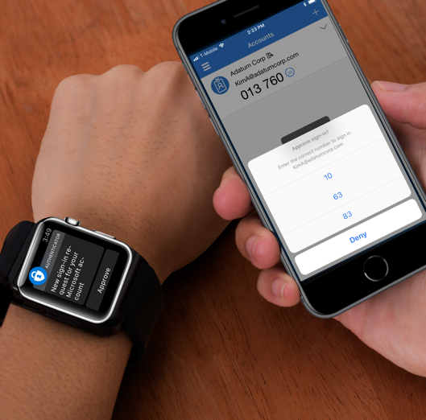



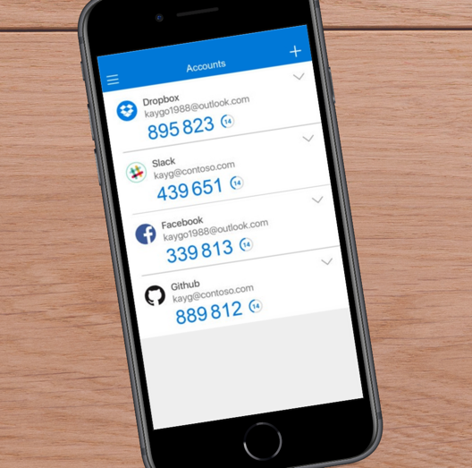
Secure authentication using MFA
PROTECT & GOVERN
Multi-factor authentication prevents 99.9% of identity attacks
Push notification
SMS
Voice call
OATH Token
OATH codes
Notes:
Passwords are your biggest vulnerability, partly because they are the target of most attacks we see today. 81% of all attacks were the result of weak/compromised credentials. But there is hope. We are investing in the next gen of authentication solutions such as password-less authentication where you can eliminate passwords entirely from the end user flow. We also continue to invest in tried and tested solutions such as MFA as well as innovative cloud-powered solutions like Azure AD Password Protection to help you secure your user credentials.
Multi-factor Authentication (MFA) can protect you against 99.9% of identity attacks including Phishing, breach replay and password spray – the most predominant identity attacks today. We heard feedback from our customers to include more options and we recently announced the support for OATH hardware tokens for MFA. There is no longer an excuse for organizations to not turn on MFA! But there is more..

Slide 28
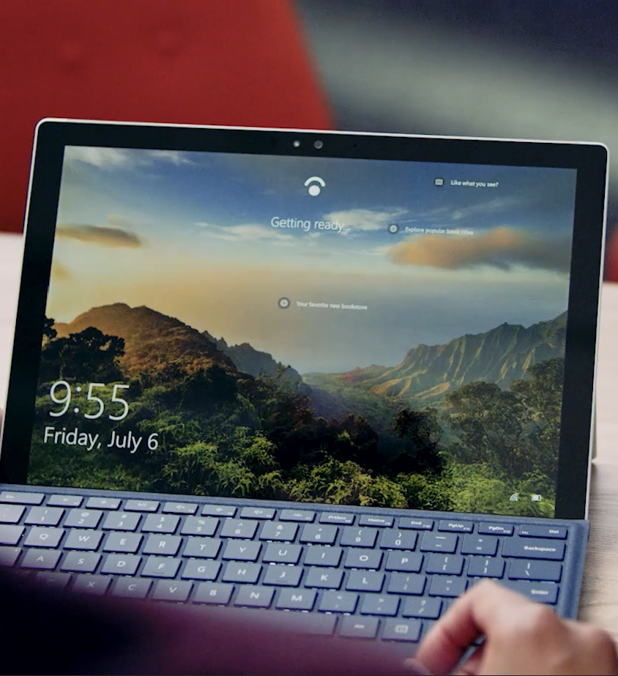
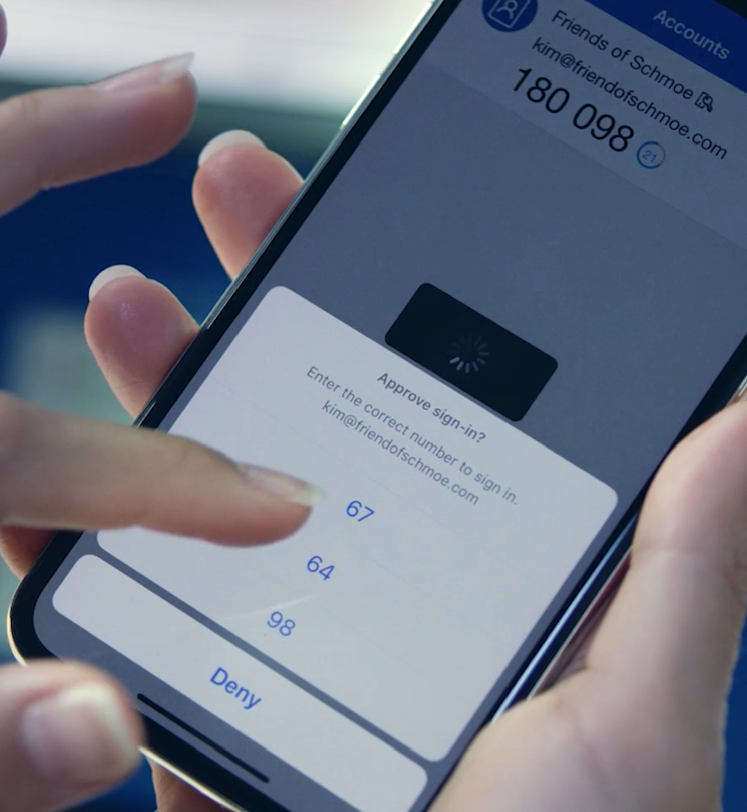
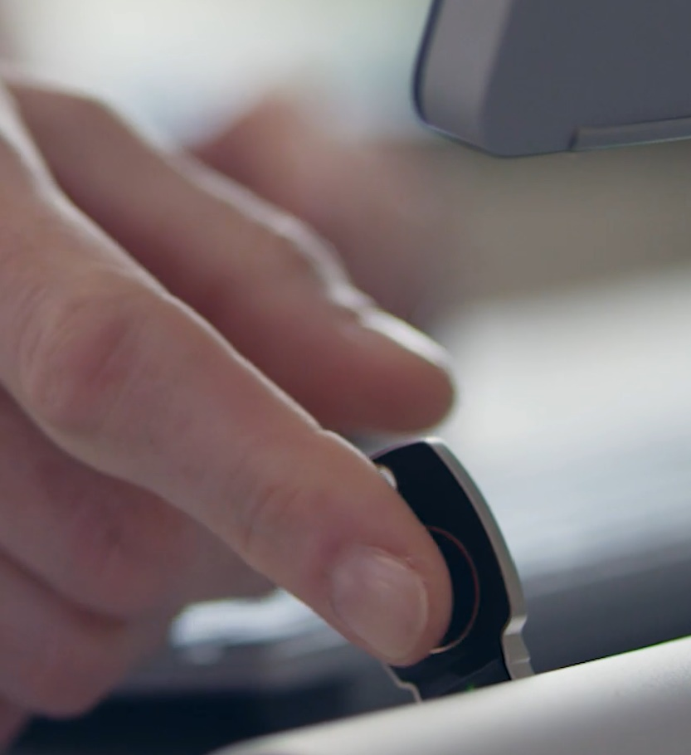
Secure authentication with password-less credentials
PROTECT & GOVERN
High security convenient methods of authentication
Windows Hello
Microsoft Authenticator
FIDO2 Security Keys
Get the whitepaper: aka.ms/gopasswordless
Notes:
Microsoft is a leader in password-less solutions for the enterprise. Starting with Windows Hello, you can sign in with your face, fingerprint, or using a Microsoft-compatible peripheral (such as a camera or external bio/badge reader) to login without typing in a username and password.
Microsoft Authenticator has (in public preview) an option for signing in with your phone – using a secured credential on the device such as Face, Fingerprint, or a PIN code and confirmation in the app that is registered to the user.
FIDO2 is a new open standard for secure authentication that locks the credentials to a device. That means you can keep identities safe wherever users roam through the cloud. FIDO2 Security keys offer greater mobility (such as Firstline workers who rotate between computers/devices).
Give users password-free access to as many apps and devices as possible
Give users as much choice as possible to avoid passwords.
Start by seeing how many of your users reuse passwords or worse, set standard passwords all the time. Hackers know and exploit this vulnerability all the time! With Azure AD Password Protection (Azure AD P1 in public preview), we help you in two ways:
Banned passwords: We provide you a global password list, one that prevents users from setting these common passwords that we see all the time at our end, and also give you the ability to define a custom banned password list. For example: Microsoft01* may not be on our global list but definitely features in the Microsoft IT’s custom banned password list. So you can leverage intelligence from the cloud as well as that from within your environment to ensure users are using strong passwords.
Smart lockout gives you the ability to define policies around how many times a wrong password can be entered before locking the user out.

Slide 29


PROTECT & GOVERN
Workloads
Conditional access
People
Intelligence
Data
Devices
Implement Zero Trust with Azure AD conditional access
Notes:
Zero Trust is a security strategy that requires you to stop assigning trust based on network location which was the standard not too many years ago. With network walls crumbling, what can you do to achieve Zero Trust. Here is where Azure AD conditional access plays a part. There are three steps to consider:
Establish identity as the control plane – Ensure your users are who they say they are using the secure authentication mechanisms we just spoke about.
Assume every service is on the open internet – Azure AD, as we already spoke about gives you the ability to connect all your apps, user identities as well as partners and customers. With solutions like app proxy, you can ensure that whenever a user accesses a resource, whether they are in your premises or not, in a Zero Trust model, you have to assume that every service is on the open internet. But how do you assign trust.
Trust nothing, verify everything – With identity as the control plane, you can now, with the help of Conditional access, use other criteria including people (the who), device (the how), workload/app (the what) and additionally intelligence to ensure that you can trust this user to access your corporate data.
With these three steps you can ensure that you are first and foremost protecting access to your data!
Azure AD conditional access enables you to take into account, for every sign-in, the user, location, device, app, risk and data before allowing access. Not all parameters are equal all the time but you definitely want the flexibility to have this level of control. We do this by using conditions and controls…

Slide 30

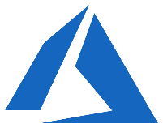
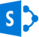
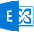



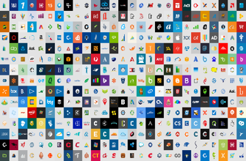
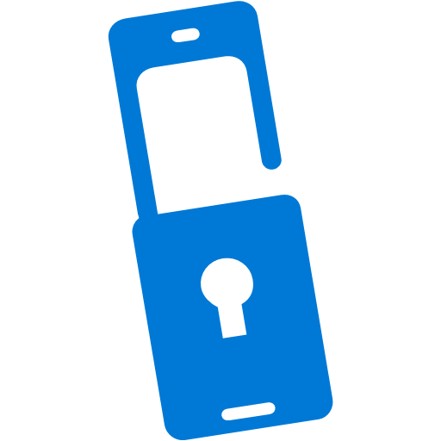

Azure AD conditional access
Azure AD
ADFS
Conditions
Controls
MSA
40TB
Google ID
Employee & Partner Users and Roles
Allow/block
access
Microsoft Cloud
Android
Session Risk
iOS
Trusted & Compliant Devices
Machine learning
3
MacOS
Limited
access
Microsoft Cloud App Security
Windows
Windows Defender ATP
Require
MFA
Real time Evaluation
Engine
Cloud SaaS apps
Force
password
reset
Geo-location
Physical & Virtual Location
******
Corporate Network
Policies
Effective policy
Client apps & Auth Method
Block legacy authentication
Browser apps
Client apps
On-premises & web apps
Notes:
Expanded view of all the conditions that are taken into account for access and the controls that you have based on the risk.
Our 40 TB of data from all the conditions, integrated EMS/M365 apps, and our security intelligence network are analyzed in real-time to determine the right policy.
Example: If an ADFS user signs in on a Windows machine with Windows Defender ATP we can take into account the health of the account and the device, as well as their location and if they are on the corporate network and what type of app they are trying to access. If they are on the corporate network in their normal office then the data produces a low risk score. The effective policy is to all access to the app. If, however, the person was logging in from a location across the world (in a short amount of time – impossible travel) and/or the Windows Defender ATP finds that the machine has been infected, the access can be blocked. If the user login and device are healthy, but it was a location they haven’t signed in from before (on a trip or other computer) then the user could be prompted with MFA or have limited access to certain applications.

Slide 31

Azure AD Identity Protection
PROTECT & GOVERN
Continuous detection
Connected intelligence
Apply artificial intelligence and human expertise to derive accurate insights
Actionable insights
Observe trillions of signals and risk events from cloud systems
Send alerts, self-mitigate, and automatically remediate threats

Slide 32
Azure AD Identity Governance
PROTECT & GOVERN
Identity lifecycle facilities collaboration
Access lifecycle provides seamless and efficient access
Privileged access lifecycle addresses risks inherent in administration
Ensure the right users have the right access to the right resources
Notes:
Ensuring you can balance productivity and security over time is a challenge. Access rights can drift as employees take on new roles and projects. When governing identity and access, you have to ask yourself 4 questions (questions on the slide). Who has / should have access to which resources?
What are they doing with that access?
Are there effective organizational controls for managing access?
Can auditors verify that the controls are working?
With Azure AD Identity Governance, we help you govern the identity lifecycle – joiner mover leaver scenarios by integrating with HR applications and assigning entitlements to , the access lifecycle – with solutions like conditional access as well as RBAC and access reviews that can help you ensure the right users have the right access to the right resources and finally your most important users – yourself, the admins with the privileged access lifecycle solutions like Azure AD PIM.

Slide 33
Azure Active Directory Develop & Integrate

Slide 34
Microsoft identity platform for developers
DEVELOP & INTEGRATE
Unified toolkit for building identity-connected applications
Reach more users
Let your users sign in with their Microsoft personal or work account or using their social accounts
Secure your application
Extend the security benefits and access controls to your customers who use Azure AD without additional code
Create powerful apps
Build the next generation of apps and experiences by connecting to the Microsoft Graph
Integrate with ease
Build with confidence with open industry standards on a trusted, reliable platform
Notes:
Questions to ask:
Is your application able to easily reach and sign in enterprise customers?
Do you want to accelerate development?
Do you want to build rich applications that can securely access user data in the Microsoft 365?
As customers move their identity systems to the cloud, there’s increasing demand from them that the applications that they use integrate with their enterprise identity system. With Azure AD as the leading cloud identity system for enterprise, it provides a tremendous opportunity for developers to integrate into this ecosystem. In doing so you, the developer and ISVs, will be able to:
Increase your market opportunity and exposure of your application within the Microsoft Identity ecosystem.
Focus on building the core functionality of their application rather than building systems for authentication.
You’ll be able to extend security features to your applications to those enterprises with Azure AD.
Build smarter applications by accessing you or your customers data in Microsoft Graph.
Let’s dive further into how integrating your application with Azure AD can further expand your market opportunity.

Slide 35

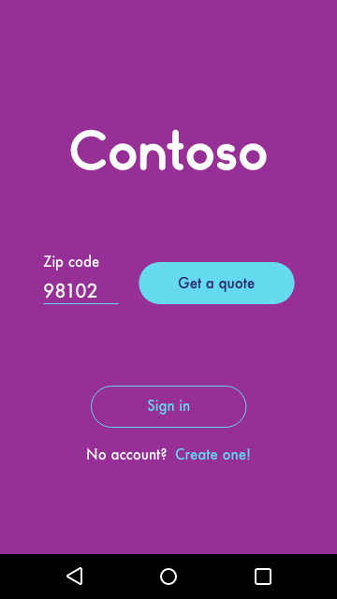
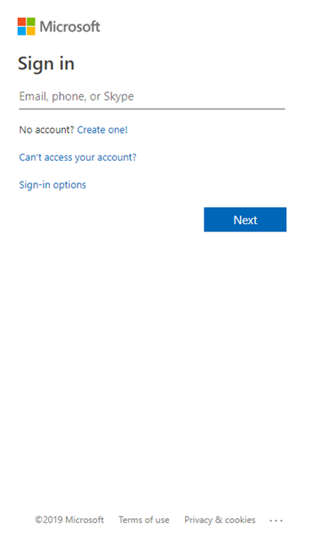
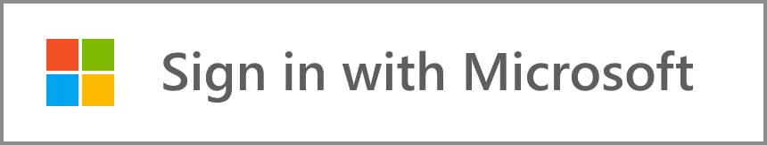
Add sign in with Microsoft
DEVELOP & INTEGRATE
Reach a broad audience
Sign in users with any Microsoft identity - Microsoft personal, work or school accounts
One less username and password for your users to remember
Reduce sign in friction and support costs

Slide 36
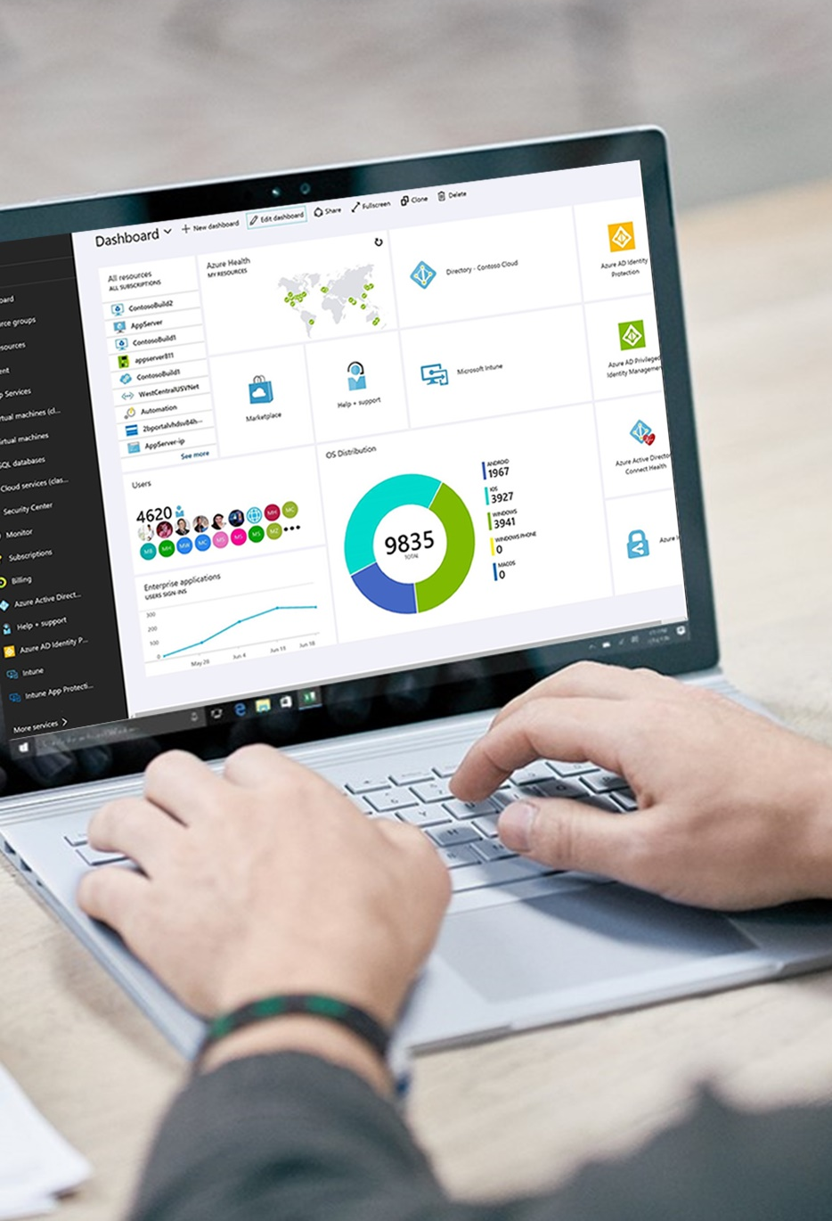
DEVELOP & INTEGRATE
Give enterprises who use Azure AD as their identity and access management system the security benefits and access controls they know and trust.
Protect your application with Azure AD
Secure access to users and their data in Microsoft APIs or your own APIs.
Build secure solutions with Microsoft Authentication Libraries available in multiple languages

Slide 37

Build smarter apps by connecting to Microsoft Graph
DEVELOP & INTEGRATE
Your app
Web Apps
Device & Native
Apps
Bots
Background
processes
1
Gateway
Microsoft Graph
Office 365
Windows 10
Enterprise Mobility + Security
Your or your customer’s data
Microsoft identity
Rich content
Deep insights
Real-time updates
Notes:
Building and integrating with Azure Active Directory also enables developers to leverage data in the Microsoft Graph. It's best to think of Microsoft Graph as an API gateway that unifies the many REST API offerings we have as a company. Today, Microsoft Graph brings together more than 25 incredibly important APIs including Azure Active Directory, productivity APIs like Exchange and OneDrive, security and management APIs like Intune and Security Graph, Windows APIs like Rome and Cloud Print, and much, much more.
Naturally, Microsoft Identity is the control plane for Microsoft Graph. By integrating with Azure Active Directory, you can better understand who and how people are utilizing Microsoft 365 – that’s Office 365, Windows and Enterprise Mobility Suite.
By leveraging the Microsoft Graph you can build better apps with:
Rich context. Get rich context for your applications, such as who someone's manager is, whether they are out of office, or what documents they've been working on.
Deep insights. Access deep insights generated from usage patterns, such as trending documents, best team meeting times, or who people typically work with.
Real-time updates. Respond to changes in Microsoft Graph data in real time. Reschedule a meeting based on responses, notify others when a file is modified, or continue a process after it's been approved.
You can build any kind of application on top of Graph – some examples include web and device native applications, but also bots and all kinds of new application types that are popping up; all the way to the background processes and daemon services that run business workflows behind the scenes.
Those apps and services leverage this incredibly rich data set from M365 (Office 365, Windows and EMS) thanks to the Microsoft Graph service, which directs the calls to the right source so the developer doesn’t need to know where exactly the data lives. Graph also aggregates calls for efficiency and performance, and allows the developer to easily traverse the graph of data. This way, it’s easy to build an app that – for example – based on a security alert in a tenant, can traverse the graph to see which users might be affected, and for each user, which devices and documents might be affected – thus making it easy to connect data from across many services to solve for real business scenarios.
Those scenarios include identity-centric scenarios (where users, and other AAD-centric data is at the center), rich content (documents, business data, and mode), deep insights based on machine learning algorithms that power some of the Graph APIs (such as people I work with, or what documents are trending around me), and real time updates of the data – for businesses that run in real time.

Slide 38
Integration Scenarios
DEVELOP & INTEGRATE
How partners are integrating with Azure Active Directory
Single sign on
User provisioning
Microsoft Graph
Let your end users easily sign in with their Microsoft identity
Automatically provision or de-provision your application to users
Connect to the data in the Microsoft Graph and build smarter applications
Notes:
There are a few common scenarios that we see developers leveraging our identity platform:
Authentication and sign-in
As mentioned earlier by using our platform to authenticate with companies that use Azure AD as their identity system, developers and ISVs have one less password to store and protect. We can handle the authentication and sign in, password reset, access controls for you and your customers who use Azure AD so you can focus on building your application.
Single Sign On (SSO)
Azure AD enables easy integration to many of today’s popular SaaS applications and enables users to single sign-on to applications directly, or discover and launch them from a portal such as Office 365. SSO means giving your customers the ability to access all of the applications and resources that your customers need to do business, by signing in only once using a single user account. Once signed in with the Azure AD, those users can access all of the applications, including yours, without being required to authenticate (for example, type a password) a second time.
User Provisioning
Not only do users not have to manage multiple sets of usernames and passwords, their applications access can be automatically provisioned or de-provisioned based on their organization group membersship, and also their status as an employee. Azure Active Directory introduces security and access governance controls that enable you to centrally manage users' access across SaaS applications. Organizations want applications to integrate with Azure AD, so when a person joins/changes/leaves an organization, they will automatically be given the right access to your application without IT needing to take extra steps. The act of creating, updating, and/or disabling user account records in an application’s local user profile store can be arduous given the number of applications organizations have and use. Integrating with Azure AD can automatically add, update, and disable user accounts.
Microsoft Graph
We’re seeing developers take advantage of the Microsoft Graph and enhancing their application with the data and APIs available to them. Build smarter apps that provide richer context about who someone is, who they know, what they are working on. Microsoft Graph also provides access to user and account risks detected by the Identity Protection service in Azure Active Directory (Azure AD), enabling you to integrate account risk data into your applications.

Slide 39

Secure your cloud infrastructure (IaaS) with Azure AD
PROTECT & GOVERN
Reduce vulnerability to credential attacks with multi-factor authentication and conditional access.
Minimize access with Azure role-based access control and Privileged Identity Management.
Stop managing local accounts for Virtual Machines with Azure AD sign in for Azure VMs
Remove credentials from your code with managed identities for Azure resources.
Notes:
[Abbreviated Talking Points]
We’re going to managed identity and AAD token enable all services in Azure
[Talking Points]
We are working hard to enable all Azure resources with managed identity, and to support Azure AD tokens.
Today at Ignite I am announcing managed identity is now Generally Available for Virtual Machines and Virtual Machine Scale Sets. These two resources, plus App Services and Functions, are the first four services enabled for managed identity that you can use when building an app on Azure.

Slide 40
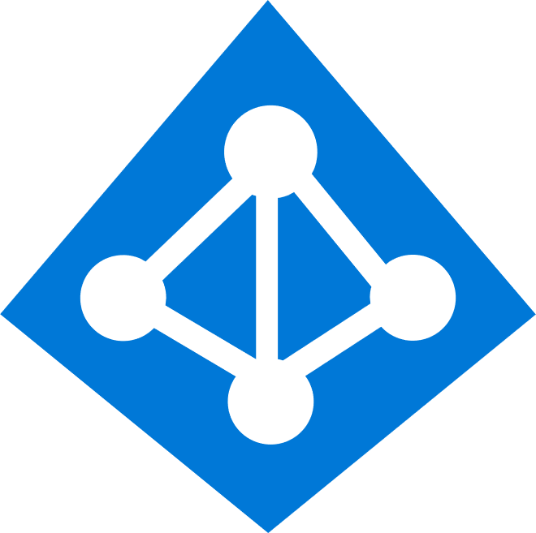
Identity is the new control plane
Cloud Apps
Partners & Customers
Employees
Identity
On-premises apps
Devices
Notes:
Identity is central to your IT strategy and your Security strategy. Getting it right can save your organization time and resources. With Azure AD you can connect all your apps, devices, and users to a single source for identity. Less points of attack and more control over how people are getting access to critical apps and data. As these nodes continue to multiply for your organization over the coming years you can meets the scalability and flexibility needs of your organization with ease.

Slide 41
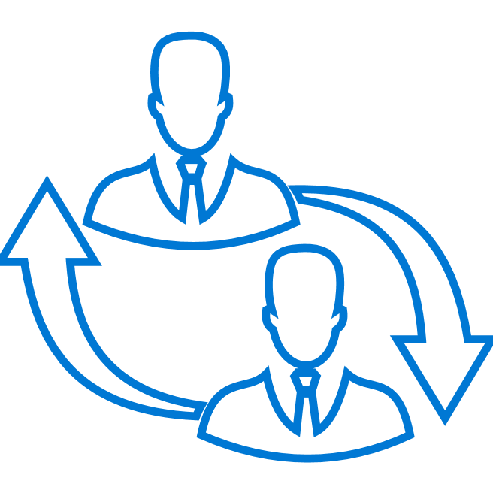
Next steps
You may already be using Azure AD!
Fast track
Expert partners and Microsoft Engineering remote assistance to accelerate your Azure AD deployment
Try Azure Active Directory today for free
Microsoft Azure Active Directory
Methodology & resources
Engineers
Tools & insights
Get to production team
Microsoft Engineers engage directly to get you up and running with Azure Active Directory
Let our team help with your implementation
Notes:
You may already be using Azure AD!
Azure AD is the authentication service to O365. Assuming the customer already has O365/Microsoft Cloud service today – they too are an Azure AD customer.
Why use another vendor?
To help you with implementation we have free Fast track services or for select customers we have a Get To Production (GTP) team that is there side-by side with you to get up and running.

Slide 42

Next steps
Enable Azure Active Directory Premium
Enable Multi-Factor Authentication (MFA)
Enable Self-service Password Reset (SSPR) with Password Protection
Develop a plan to move your apps to Azure AD
Notes:
End on this if customer is new to Azure AD. Balance of productivity and security.
Enable Azure AD Premium (P1 is in M365/EMS E3 and P2 is in M365/EMS E5)
Enable MFA – passwords are the #1 source for breaches and should be protected with MFA. Apply Conditional Access for more control over when to require MFA. Get more insights and risk scoring with P2.
Enable Self-Service – password resets are a huge cost that you can minimize with self-service options. Password Protection is a feature that can block common passwords (from our database or customized for you) from being used.
Connect all your apps – Azure AD can connect to any cloud or web-enabled app you have. Do an audit (the MS Cloud App Discovery tool can help) and start getting more apps connected to Azure AD for optimal control and visibility.

Slide 43
Thank you

Slide 44
Five Steps to Protect Against Threats with Azure AD
Strengthen your credentials
Increase your awareness with auditing and monitor security alerts
MFA reduces compromise by 99.99%
Attackers escape detection inside a victim’s network for a median of 101 days. (Source: FireEye)
Reduce your attack surface
Blocking legacy authentication reduces compromise by 66%.
Enable self-help for more predictable and complete end user security
Automate threat response
60% of enterprises experienced social engineering attacks in 2016. (Source: Agari)
Implementing risk policies reduces compromise by 96%
Notes:
For customers who want to do a quick security audit for identity.
5 steps is also online: https://query.prod.cms.rt.microsoft.com/cms/api/am/binary/RE2KJVp
#1 is on the To-Do list for new to Azure AD Premium
Eliminating use of older, less secure protocols, limiting access entry points, and exercising more significant control of administrative access to resources can help reduce the attack surface area.

